Slide 1
CASE (Computer Aided Software Engineering)
Software that is used to support software development and evolution processes
Provides software process support by automating some process activities providing information about the software being developed
Currently used in every phase of the software life cycle

Slide 2
Organizations use CASE tools to:
Improve the quality of the system
Increase speed of design and development
Ease and improve the testing process
Improve integration of development activities
Improve quality and completeness of documentation
Improve management of the project
Simplify program maintenance
Promote reusability

Slide 3
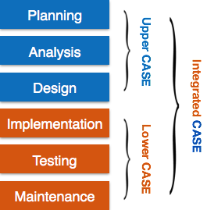

Slide 4
CASE tools
Upper CASE tools: support for the analysis and design
(front-end tools)
Assist developer during requirements, analysis, and design activities
Lower CASE tools: support for construction and maintenance
(back-end tools)
Assist with implementation, testing, and maintenance activities

Slide 5
Activity automation
Graphical editors for system model development;
Data dictionary to manage design entities;
Graphical UI builder for user interface construction;
Debuggers to support program fault finding;
Automated translators to generate new versions of a program.

Slide 6
CASE tools: Automated Diagram Support
Checks for syntactic correctness
Data dictionary support
Checks for consistency and completeness
Navigation to linked diagrams
Requirements traceability
Automatic report generation
System simulation
Performance analysis

Slide 7
CASE tools: Software construction and maintenance
Code generators
…Generate code from the design model…
Think of the advantages!
may also generate database schema
Maintenance tools
Reverse Engineering
Analysis of program code

Slide 8
CASE Tools Benefits Improve software quality Enforce discipline
Help standardize notations and diagrams
Help communication between development team members
Information is illustrated through diagrams that are typically easier to understand
Development information is centralized
Advanced CASE tools are complex applications that require significant training and experience to achieve real benefits
Often CASE serves only as a glorified diagramming tool that supports the practices of behavioral and structural modeling
Has been shown to be a helpful way to support the communication and sharing of project diagrams and technical specifications (as long as it is used by trained developers who have applied CASE on past projects)
Enforce discipline
By helping with the standardization of notations and diagrams
Tasks are much faster to complete and alter
Enhance reuse of models or models’ components
Can reduce maintenance costs

